Slide 1
Lisons Mieux
Let's read better!
Angela Drake

Slide 2
Introduction (1/18) How will this training help me?
By taking this training, you will
strengthen your literacy skills
enrich your vocabulary, and
raise your scores on the verbal sections of standardized texts.

Slide 3
Introduction (2/18) How will this training help me?
Additionally, you will be able to identify unfamiliar words in order to understand the responses from your French pen pal. You cannot learn all of the vocabulary of any language, and you cannot expect native speakers to only use vocabulary that you have been taught. You must be able to puzzle out the meaning of unfamiliar words.

Slide 4
Introduction (3/18) How will this training help me?
Finally, you will be able to use the strategies suggested in this training in other courses, both in high school and in college. By activating your background knowledge of English and by using the context clues provided, you will be able to increase your understanding of writing in any discipline you study.

Slide 5
Introduction (4/18) Objectives
Objective 1: In this training, you will use your background knowledge of English to help you understand the meaning of a passage of text.

Slide 6
Introduction (5/18) Objectives
Objective 1: In this training, you will use your background knowledge of English to understand the meaning of a passage of text.
Goal 1.1: Using your knowledge of English, identify the meaning of unfamiliar words by recognizing cognates in an authentic passage of text.

Slide 7
Introduction (6/18) Objectives
Objective 1: In this training, you will use your background knowledge of English to understand the meaning of a passage of text.
Goal 1.2: Using your knowledge of English and French prefixes and suffixes, identify the meaning of unfamiliar words in an authentic passage of text.

Slide 8
Introduction (7/18) Objectives
Objective 1: In this training, you will use your background knowledge of English to understand the meaning of a passage of text.
Goal 1.3: Using your knowledge of English and French plurals, identify the meaning of unfamiliar words in an authentic passage of text.

Slide 9
Introduction (8/18) Objectives
Objective 2: In this training, you will also use a variety of context clues to help you understand the meaning of unfamiliar words.

Slide 10
Introduction (9/18) Objectives
Objective 2: In this training, you will use also use a variety of context clues to help you understand the meaning of unfamiliar words.
Goal 2.1 By examining word order, find the meaning of unfamiliar words in an authentic passage of text.

Slide 11
Introduction (10/18) Objectives
Objective 2: In this training, you will use also use a variety of context clues to help you understand the meaning of unfamiliar words.
Goal 2.2: Using the clues that pictures, headings and captions provide, identify the meaning of unfamiliar words in an authentic passage of text.

Slide 12
Introduction (11/18) How to navigate this training
Each Goal will include:
A title page
A pre-test question
Narrated instruction
A practice question

Slide 13
Introduction (12/18) How to navigate this training
Posttest
At the conclusion of the training, you will be asked to complete a posttest.
On the last page of this training, you will click on a link to a Google Form to complete the posttest.

Slide 14
Introduction (13/18) How to navigate this training
Click the Home Button to return to the title page

Slide 15
Introduction (14/18) How to navigate this training
Click the back arrow to go back one page.
Click the forward arrow to go forward one page.

Slide 16
Introduction (15/18) How to navigate this training
Click on the Info Button to view the navigation instructions again.

Slide 17
Introduction (16/18) How to navigate this training
Click on each icon to navigate directly to Instruction for a specific goal.

Slide 18
Introduction (17/18) How to navigate this training
Click the “end” arrow to advance to the end of a section.
You can also bypass training by answering pre-test questions correctly.
You will be prompted to click on the end arrow at that time.

Slide 19
Introduction (18/18) How to navigate this training
Click the star to go to the beginning of the section you are currently in.

Slide 20
Objective 1 In this section, you will use your knowledge of English to negotiate the meaning of unfamiliar words in an authentic text.

Slide 21
Goal 1.1: Use cognates/words that resemble familiar words

Slide 22
Pretest Goal 1.1: Use cognates/words that resemble familiar words
Pre-test: Assessment Item 1.1.1
Read the passage fully. Review each of the four choices completely before selecting an answer.
You will proceed directly to Goal 1.2 if you answer this question correctly.

Slide 23
Pretest Goal 1.1: Use cognates/words that resemble familiar words
Pre-test: Assessment Item 1.1.1
Identify the meaning of French words
based on their similarities to English words.
When is the Chateau de Versailles open from 9h to 18h30?
a) January- May
c) November- March
b) April-October
d) December- April
(DeMado, Champery, M. Ponterio, & R. Ponterio, 2008, p. 363)

Slide 24
Pretest Goal 1.1: Use cognates/words that resemble familiar words
Pre-test: Assessment Item 1.1.1
Identify the meaning of French words
based on their similarities to English words.
When is the Chateau de Versailles open from 9h to 18h30?
A) January- May is not correct.
Be sure to find the section with the times listed, and take a closer look at the names of the months.
Begin this section by clicking on the star.
(DeMado, Champery, M. Ponterio, & R. Ponterio, 2008, p. 363)

Slide 25
Pretest Goal 1.1: Use cognates/words that resemble familiar words
Pre-test: Assessment Item 1.1.1
Identify the meaning of French words
based on their similarities to English words.
When is the Chateau de Versailles open from 9h to 18h30?
B) Great job! “Avril-octobre” does indeed resemble the months April and October.
Click on the end arrow to advance to the next goal.
(DeMado, Champery, M. Ponterio, & R. Ponterio, 2008, p. 363)

Slide 26
Pretest Goal 1.1: Use cognates/words that resemble familiar words
Pre-test: Assessment Item 1.1.1
Identify the meaning of French words
based on their similarities to English words.
When is the Chateau de Versailles open from 9h to 18h30?
C) November- March is not correct. Take another look, and pay closer attention to the time listed in the question.
Begin this section by clicking on the star.
(DeMado, Champery, M. Ponterio, & R. Ponterio, 2008, p. 363)

Slide 27
Pretest Goal 1.1: Use cognates/words that resemble familiar words
Pre-test: Assessment Item 1.1.1
Identify the meaning of French words
based on their similarities to English words.
When is the Chateau de Versailles open from 9h to 18h30?
D) December- April is not correct. Be sure to find the section with the times listed, and take a closer look at the names of the months.
Begin this section by clicking on the star.
(DeMado, Champery, M. Ponterio, & R. Ponterio, 2008, p. 363)

Slide 28
Instruction (1/2) Goal 1.1: Use cognates/words that resemble familiar words
Cognates are words with the same meaning and similar spelling in both French and English. The pronunciation may differ just a bit.

Slide 29
Instruction (2/2) Goal 1.1: Use cognates/words that resemble familiar words
Here are some examples of cognates:
la liberté | la musique | entier
le football | nerveux | la nation
horrible | l’expert | l’horizon
la nature | le danger | la cage
les mathématiques | brilliant | un catastrophe

Slide 30
Practice Goal 1.1: Use cognates/words that resemble familiar words
Now apply what you have just read to practice
with a new passage of text.
The answer will be immediately provided on the following slide along with an explanation on how to best arrive at the correct answer.
Notes:
The answer will be immediately provided on the following slide along with an explanation on how to best arrive at the correct answer.

Slide 31
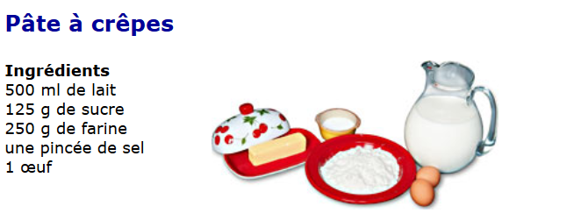
Practice Goal 1.1: Use cognates/words that resemble familiar words
In order to make crepes, you will need 125g of:
a) salt b) soup
c) sausage d) sugar

Slide 32
Practice Goal 1.1: Use cognates/words that resemble familiar words
In order to make crepes, you will need 125g of: D) Sugar.
Did you guess that sugar was the word after the measurement of 125g since “sucre” looks so similar to the English word sugar?

Slide 33
Goal 1.2: Use your knowledge of prefixes and suffixes

Slide 34
Pretest Goal 1.2: Use your knowledge of prefixes and suffixes
Pre-test: Assessment Item 1.2.1
Read the passage fully. Review each of the four choices completely before selecting an answer.
You will proceed directly to Goal 1.3 if you answer this question correctly.

Slide 35
Pretest Goal 1.2: Use your knowledge of prefixes and suffixes
Pre-test: Assessment Item 1.2.1
(DeMado et al., 2008, p. 379)

Slide 36
Pretest Goal 1.2: Use your knowledge of prefixes and suffixes
Pre-test: Assessment Item 1.2.1
In the line 13 of the passage, what does the phrase “ma mère me déposa à ma place” mean?
a) My mother kissed me where I was...
b) My father kissed me where I was…
c) My mother took me from where I was ...
d) My father took me from where I was…

Slide 37
Pretest Goal 1.2: Use your knowledge of prefixes and suffixes
Pre-test: Assessment Item 1.2.1
In the line 13 of the passage, what does the phrase “ma mère me déposa à ma place” mean?
A) My mother kissed me where I was... is not correct.
Pay close attention to the prefix used in the verb.
Begin this section by clicking on the star.

Slide 38
Pretest Goal 1.2: Use your knowledge of prefixes and suffixes
Pre-test: Assessment Item 1.2.1
In the line 13 of the passage, what does the phrase “ma mère me déposa à ma place” mean?
B) My father kissed me where I was… is not correct. Pay close attention to the prefix used in the verb. Also, investigate what “mon père” in the title means, and try to figure out what “ma mère” in the sample sentence means.]
Begin this section by clicking on the star.

Slide 39
Pretest Goal 1.2: Use your knowledge of prefixes and suffixes
Pre-test: Assessment Item 1.2.1
In the line 13 of the passage, what does the phrase “ma mère me déposa à ma place” mean?
C) My mother took me from where I was ... is correct!
The prefix “de-” does indicate removal or undoing of an action. Additionally, “-pos” could indicate the speaker’s position in the room.
Click on the end arrow to advance to the next goal.

Slide 40
Pretest Goal 1.2: Use your knowledge of prefixes and suffixes
Pre-test: Assessment Item 1.2.1
In the line 13 of the passage, what does the phrase “ma mère me déposa à ma place” mean?
D) Close! My father took me from where I was ... is not correct. The prefix “de-” does indicate removal or undoing of an action. You have guessed the right verb from the prefix. However, “ma mère” in sample the sentence does means “my mother.”
Begin this section by clicking on the star.

Slide 41
Instruction (1/6) Goal 1.2: Use your knowledge of prefixes and suffixes
Prefixes are letters that are added to the
beginning a word in order to adjust or clarify its meaning.

Slide 42
Instruction (2/6) Goal 1.2: Use your knowledge of prefixes and suffixes
Some examples of shared English and
French prefixes:
English/French prefixes | English/ French words
uni-, bi -, and tri- to signify the word relates to one, two or three things | uniform/l’uniform, bicycle/une bicyclette, triangle/un triangle
re- to signify doing something again | redo/refaire, revise/reviser, recount/raconter

Slide 43
Instruction (3/6) Goal 1.2: Use your knowledge of prefixes and suffixes
Some examples of shared English and
French prefixes:
English/French prefixes | English/ French words
pre- and post- to indicate before and after an event | prehistoric/préhistorique, prelude/un prélude, postlude/postlude, postscript/le post-scriptum

Slide 44
Instruction (4/6) Goal 1.2: Use your knowledge of prefixes and suffixes
Some examples of shared English and
French prefixes:
English/French prefixes | English/ French words
trans- and tele- to indicate the idea of across/beyond/over a distance | la transportation, le téléphone, la télévision
dis- or de-/dé to indicate the undoing of an action or taking something away | disobey/désobéir, decontaminate/décontaminer

Slide 45
Instruction (5/6) Goal 1.2: Use your knowledge of prefixes and suffixes
Suffixes are letters that are added to the
ending of a word in order to adjust or clarify its meaning.

Slide 46
Instruction (5/6) Goal 1.2: Use your knowledge of prefixes and suffixes
Some examples of shared English and
French suffixes:
English/French sufffixes | English/ French words
-able: to mean to be able or capable | agreeable/agréable, portable, excusable
-an/-ain, -ien, -en or –ish/-ais: to tell about nationality | American/américain, Italian/italien, Korean/coréen, Irish/irlandais

Slide 47
Instruction (6/6) Goal 1.2: Use your knowledge of prefixes and suffixes
Some examples of shared English and
French suffixes:
English/French sufffixes | English/ French words
-tor/-teur and –ist/-iste: to indicate a person that does something | actor/acteur, soloist/soliste, pianist/pianiste
-ism/-isme: to mean a profession or a state of being | journalism/le journalisme, socialism/le socialisme

Slide 48
Practice Goal 1.2: Use your knowledge of prefixes and suffixes
Now apply what you have just read to
practice with a new passage of text.

Slide 49
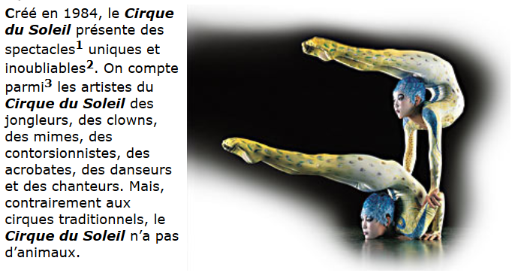
Practice Goal 1.2: Use your knowledge of prefixes and suffixes
Tell which performer is not in a Cirque de Soleil troupe (according to this passage.)
musician
juggler
dancer
contortionist
(DeMado et al., 2008, p. 366)

Slide 50
Practice Goal 1.2: Use your knowledge of prefixes and suffixes
Tell which performer is not in a Cirque de Soleil troupe (according to this passage.)
Musician is the correct answer.
While singers (des chanteurs) are mentioned, the role of a musician (un musician) is not listed in this passage.
(DeMado et al., 2008, p. 366)

Slide 51
Goal 1.3: Use your knowledge of rules for making nouns plural

Slide 52
Pre-test Goal 1.3: Use your knowledge of rules for making nouns plural
Pre-test: Assessment Item 1.3.1
Read the passage fully. Review each of the four choices completely before selecting an answer.
You will proceed directly to Goal 2.1 if you answer this question correctly.
Notes:
Narration will resume at Instruction or the next goal

Slide 53
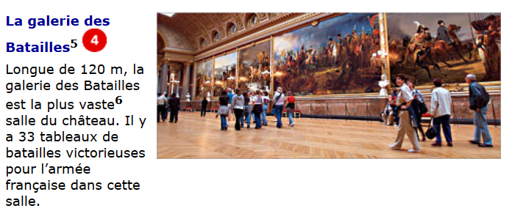
Pre-test Goal 1.3: Use your knowledge of rules for making nouns plural
Pre-test: Assessment Item 1.3.1
(DeMado et al., 2008, p. 363)

Slide 54
Pre-test Goal 1.3: Use your knowledge of rules for making nouns plural
Pre-test: Assessment Item 1.3.1
What does “la galerie des batailles” commemorate?
a) a vast castle
b) the French army
c) the battle gallery
d) victorious battles

Slide 55
Pre-test Goal 1.3: Use your knowledge of rules for making nouns plural
Pre-test: Assessment Item 1.3.1
What does “la galerie des batailles” commemorate?
A vast castle is not correct. A vast castle is singular, however the question asks about something plural.
Begin this section by clicking on the star.

Slide 56
Pre-test Goal 1.3: Use your knowledge of rules for making nouns plural
Pre-test: Assessment Item 1.3.1
What does “la galerie des batailles” commemorate?
B) The French army is singular, and the question asks about something plural.
Begin this section by clicking on the star.

Slide 57
Pre-test Goal 1.3: Use your knowledge of rules for making nouns plural
Pre-test: Assessment Item 1.3.1
What does “la galerie des batailles” commemorate?
C) The battle gallery is not correct. Remember, you are seeking what the gallery is commemorating, not telling what “la galerie des batailles” means.
Begin this section by clicking on the star.

Slide 58
Pre-test Goal 1.3: Use your knowledge of rules for making nouns plural
Pre-test: Assessment Item 1.3.1
What does “la galerie des batailles” commemorate?
D) Victorious battles is correct! “Les batailles glorieuses” and the heading “la galerie des batailles” do indeed refer to plural battles.
Click on the end arrow to advance to the next goal.

Slide 59
Instruction (1/3) Goal 1.3: Use your knowledge of rules for making nouns plural
Recognizing plurals in both English and French
can help you to understand a text.
Singular: indicating just one person or thing
Plural: indicating more than one person or thing

Slide 60
Instruction (2/3) Goal 1.3: Use your knowledge of rules for making nouns plural
In English, to make something plural, you
simply add an –s. In French, this is generally done as well.
book→ books | le livre→ les livres
shoe→ shoes | la chaussure→ les chaussures
hand→hands | la main→ les mains

Slide 61
Instruction (3/3) Goal 1.3: Use your knowledge of rules for making nouns plural
Where in English, irregular plurals do not follow
hard rules, French irregular plurals do:
ox→ oxen box→ boxes goose→ geese moose→ moose | mouse→ mice house → houses Child → children person → people
un bureau→des bureaux un tableau→ des tableaux | un cheval→ des chevaux un journal→ des journaux

Slide 62
Practice Goal 1.3: Use your knowledge of rules for making nouns plural
Now practice what you just read with a new
passage of text.

Slide 63
Practice Goal 1.3: Use your knowledge of rules for making nouns plural
(DeMado et al., 2008, p. 363)
What does the word “orangers” mean?
a) landscape architect b) orange trees
c) pools of water d) paths

Slide 64
Practice Goal 1.3: Use your knowledge of rules for making nouns plural
(DeMado et al., 2008, p. 363)
What does the word “orangers” mean? B) Orange trees.
Did you guess that the plural word “orangers” meant orange trees? Additionally, there are orange trees shown in the photo.

Slide 65
Objective 2 In this last section, you will use context clues from the text to negotiate the meaning of unfamiliar words.

Slide 66
Goal 2.1: Examine word order

Slide 67
Pre-test Goal 2.1: Examine word order
Pretest: Assessment Item 2.1.1
Read the passage fully. Review each of the four choices completely before selecting an answer.
You will proceed directly to Goal 2.2 if you answer this question correctly.

Slide 68
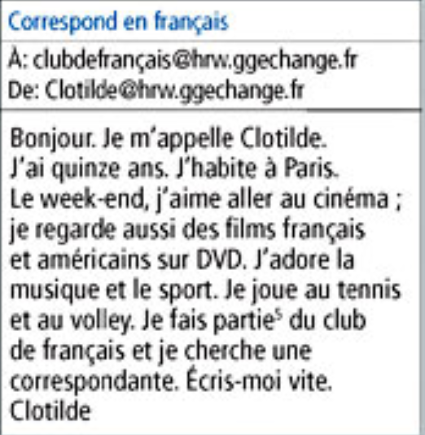
Pre-test Goal 2.1: Examine word order
Pretest: Assessment Item 2.1.1
In the phrase, “je cherche un correspondante,” what is the writer looking for?
a) a pen pal
b) someone to go to the cinema with
c) a tennis partner
d) a French tutor
(DeMado et al., 2008, p. 30)

Slide 69
Pre-test Goal 2.1: Examine word order
Pretest: Assessment Item 2.1.1
In the phrase, “je cherche un correspondante,” what is the writer looking for?
A pen pal, or a correspondant, is correct!
“Je cherche un correspondante” does indeed mean that the writer is saying the following:
Je = I, cherche = am looking for, un correspondant= a pen pal
Click on the end arrow to advance to the next goal.
(DeMado et al., 2008, p. 30)

Slide 70
Pre-test Goal 2.1: Examine word order
Pretest: Assessment Item 2.1.1
In the phrase, “je cherche un correspondante,” what is the writer looking for?
B) “Someone to go to the cinema with” is not correct. The text does mention an interest in movies, but not in this sentence.
Begin this section by clicking on the star.
(DeMado et al., 2008, p. 30)

Slide 71
Pre-test Goal 2.1: Examine word order
Pretest: Assessment Item 2.1.1
In the phrase, “je cherche un correspondante,” what is the writer looking for?
C) A tennis partner is not correct. The text does mention an interest in playing tennis, but not in this sentence.
Begin this section by clicking on the star.

Slide 72
Pre-test Goal 2.1: Examine word order
Pretest: Assessment Item 2.1.1
In the phrase, “je cherche un correspondante,” what is the writer looking for?
D) A French tutor is not correct. Clothide mentions being part of a French club. There is no mention of her needing a “tuteur” for French.
Begin this section by clicking on the star.
(DeMado et al., 2008, p. 30)

Slide 73
Instruction (1/23) Goal 2.1: Examine word order
You can use context clues from the page to help
you understand what a word means.
The order of each word will give you a clue to its function.
Knowing the word’s function in the sentence will help to determine what the meaning of the word is.

Slide 74
Instruction (2/23) Goal 2.1: Examine word order
To do this, you must first know what a subject,
verb and direct object are.

Slide 75
Instruction (3/23) Goal 2.1: Examine word order
The subject of the sentence is the person
doing the action.
SUBJECT

Slide 76
Instruction (4/23) Goal 2.1: Examine word order
Let’s identify the subject of the following
sentence in English:
We are language learners.
We are language learners.
Adam and Emily speak French.
Adam and Emily speak French
English shares words with French.
English shares words with French.
SUBJECT

Slide 77
Instruction (5/23) Goal 2.1: Examine word order
Now let’s identify the subject of the
sentences in French:
Tu parles français.
Tu parles français.
Vous aimez l’école?
Vous aimez l’école?
Stéphanie et Lauren ont 16 ans.
Stéphanie et Lauren ont 16 ans.
SUBJECT

Slide 78
Instruction (6/23) Goal 2.1: Examine word order
Next, we need to know what the verb does in a sentence.

Slide 79
Instruction (7/23) Goal 2.1: Examine word order
The verb is the action word or the linking word in a sentence. It tells what happens in the sentence.
VERB

Slide 80
Instruction (8/23) Goal 2.1: Examine word order
Let’s identify the verb of the following sentences in English:
I am 15 years old.
I am 15 years old.
She has a cold.
She has a cold.
Devon and Rosalie play golf.
Devon and Rosalie play golf.
VERB

Slide 81
Instruction (9/23) Goal 2.1: Examine word order
Now let’s identify the verb of the sentences in French:
Mon mari et moi, nous avons 30 ans.
Mon mari et moi, nous avons 30 ans.
Evelyn et Paul, vous mangez la pizza ?
Evelyn et Paul, vous mangez la pizza ?
Thierry est un garçon.
Thierry est un garçon.
VERB

Slide 82
Instruction (10/23) Goal 2.1: Examine word order
Finally, we need to know what the direct object does in the sentence.

Slide 83
Instruction (11/23) Goal 2.1: Examine word order
The direct object is the person or thing that receives the action of the verb.
DIRECT
OBJECT

Slide 84
Instruction (12/23) Goal 2.1: Examine word order
Let’s identify the direct object in a sentence in English:
Teachers have students.
Teachers have students.
We grade tests.
We grade tests.
Do you take tests?
Do you take tests?
DIRECT
OBJECT

Slide 85
Instruction (13/23) Goal 2.1: Examine word order
Let’s identify the direct object in a sentence in French:
Les professeurs ont les élèves.
Les professeurs ont les élèves.
Nous notons les examens.
Nous notons les examens.
Vous passez les examens?
Vous passez les examens?
DIRECT
OBJECT

Slide 86
Instruction (14/23) Goal 2.1: Examine word order
In a typical sentence, words are put in order of their function in the sentence:
Subject + verb + direct object
I eat apples.
DIRECT
OBJECT

Slide 87
Instruction (15/23) Goal 2.1: Examine word order
Let’s create some ridiculous words using the subject, verb, object structure.
Then let’s answer some factual questions about a sentence that is composed entirely of unknown words.
DIRECT
OBJECT

Slide 88
Instruction (16/23) Goal 2.1: Examine word order
Schnoogal legaggins plestulens.
Who legaggins plestulens?
Schnoogal does.
SUBJECT

Slide 89
Instruction (17/23) Goal 2.1: Examine word order
Schnoogal legaggins plestulens.
What does Schnoogal legaggin?
Schnoogal legaggins plestulens, of course!
DIRECT
OBJECT

Slide 90
Instruction (18/23) Goal 2.1: Examine word order
Schnoogal legaggins plestulens.
What does Schnoogal do?
Schnoogal legaggins, of course!
VERB

Slide 91
Instruction (19/23) Goal 2.1: Examine word order
So, now you know that you can use word order to anticipate what the word’s function is in the sentence.

Slide 92
Instruction (20/23) Goal 2.1: Examine word order
What happens when there are introductory phrases that might change the subject verb pattern that you have been seeing?

Slide 93
Instruction (21/23) Goal 2.1: Examine word order
What happens when there are introductory phrases that might change the subject verb pattern that you have been seeing?
To start a sentence, writers sometimes include an introductory phrase and adverbs.
Pour commencer une phrase, l’écrivain inclut une phrase introductoire et des adverbes.
SUBJECT

Slide 94
Instruction (22/23) Goal 2.1: Examine word order
What happens when there are introductory phrases that might change the subject verb pattern that you have been seeing?
To start a sentence, writers sometimes include an introductory phrase and adverbs.
Pour commencer une phrase, l’écrivain inclut une phrase introductoire et des adverbes.
VERB

Slide 95
Instruction (23/23) Goal 2.1: Examine word order
What happens when there are introductory phrases that might change the subject verb pattern that you have been seeing?
To start a sentence, writers sometimes include an introductory phrase and adverbs.
Pour commencer une phrase, l’écrivain inclut une phrase introductoire et des adverbes.
DIRECT
OBJECT

Slide 96
Practice Goal 2.1: Identify parts of speech
Now apply what you have just read to practice
with a new passage of text.

Slide 97
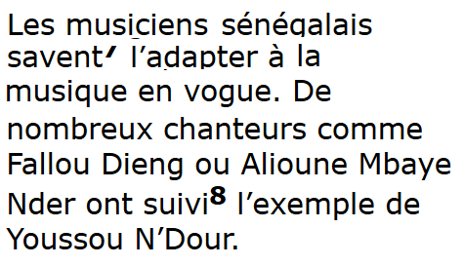
Practice Goal 2.1: Identify parts of speech
Who knows how to adapt to popular music?
Numerous singers
Fallou Dieng and Aliouns Mbaya Nder
Senegalese musicians
Youssou N’Dour

Slide 98
Practice Goal 2.1: Identify parts of speech
Who knows how to adapt to popular music?
C) Senegalese musicians are the subject of the first sentence. The verb is “savent adapter.”

Slide 99
Goal 2.2: Use pictures, headings, and captions

Slide 100
Pre-test Goal 2.2: Use pictures, headings, and captions
Pretest: Assessment Item 2.2.1
Read the passage fully. Review each of the four choices completely before selecting an answer.
You will proceed to directly to the posttest if you answer this question correctly.
Notes:
Narration will resume at instruction or in the Conclusion section

Slide 101
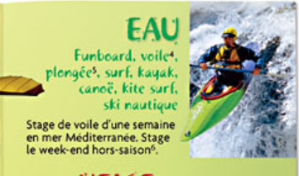
Pre-test Goal 2.2: Use pictures, headings, and captions
Pretest: Assessment Item 2.2.1
(DeMado et al., 2008, p. 174)

Slide 102
Pre-test Goal 2.2: Use pictures, headings, and captions
Pretest: Assessment Item 2.2.1
What does the word “eau” mean”?
a) the Mediterranean Sea
b) fun
c) water
d) kayaking

Slide 103
Pre-test Goal 2.2: Use pictures, headings, and captions
Pretest: Assessment Item 2.2.1
What does the word “eau” mean”?
A) Sorry! While the Mediterranean Sea, la mer Méditerranée, is written in the text, it is not the heading, “Eau, ”of this text.
Begin this section by clicking on the star.
(DeMado et al., 2008, p. 174)

Slide 104
Pre-test Goal 2.2: Use pictures, headings, and captions
Pretest: Assessment Item 2.2.1
What does the word “eau” mean”?
B) Not quite. While this activity does look like fun, the word “Eau” will relate to both the photo and the activities listed in the text.
Begin this section by clicking on the star.
(DeMado et al., 2008, p. 174)

Slide 105
Pre-test Goal 2.2: Use pictures, headings, and captions
Pretest: Assessment Item 2.2.1
What does the word “eau” mean”?
C) Nicely done! The photo, along with the words funboard, surf, kayak and nautique, all draw you to devine that the heading, “eau,” means water.
Click on the end arrow to advance to the posttest
(DeMado et al., 2008, p. 174)

Slide 106
Pre-test Goal 2.2: Use pictures, headings, and captions
Pretest: Assessment Item 2.2.1
What does the word “eau” mean”?
D) Nice attempt. While kayaking is the activity in the photo, the text does indeed mention the activity of kayaking, so “eau” probably does not mean kayaking.
Begin this section by clicking on the star.
(DeMado et al., 2008, p. 174)

Slide 107
Instruction (1/3) Goal 2.2: Use pictures, headings, and captions
A word’s position on the page might give away
its function, its purpose, or its meaning.
Titles at the top of the page, headings at the top of a section, and captions below or next to a picture can give you a sense of what the page, section, or picture is about.

Slide 108
Instruction (2/3) Goal 2.2: Use pictures, headings, and captions
A word’s position on the page might give away
its function, its purpose, or its meaning.
Captions provide a summary of a picture, text box or diagram.

Slide 109
Instruction (3/3) Goal 2.2: Use pictures, headings, and captions
A word’s position on the page might give away
its function, its purpose, or its meaning.
You can use pictures to give you clues to unfamiliar words. Pictures are chosen with great care by publishers to draw interest to the page and give additional meaning to the text.

Slide 110
Practice Goal 2.2: Use pictures, headings, and captions
Now apply what you’ve just read with a new passage of text.

Slide 111
Practice Goal 2.2: Use pictures, headings, and captions
La sabar, la cora, le djembé and le balafon are examples of :
a) Senegalese poets, singers and musicians
b) Oral traditions
c) types of traditional Senegalese instruments

Slide 112
Practice Goal 2.2: Use pictures, headings, and captions
La sabar, la cora, le djembé and le balafon are examples of :
C) The correct answer is “types of traditional Senegalese instruments.”
Both the heading and the sentence with these particular terms indicate these are tradition instruments.

Slide 113
Conclusion
You have completed the module to help you decode language using a variety of tools. You now have more skills that will help you decipher the meaning of unfamiliar words!

Slide 114
Conclusion
References:
DeMado, J., & Champeny, S. Ponterio, M, and Ponterio, R. (2008). Holt French. Bien dit! 1 1. Orlando, Fla.: Holt, Rinehart and Winston.

Slide 115
Conclusion
Click on the hyperlink to the posttest to evaluate the effectiveness of this training.

